Slide 1


Teamwork Platform
A Flutter-Based Collaboration Tool
Presented by: Group 3

Slide 2
Project Overview
Goal:
To build a cross-platform Flutter application for real-time collaboration and project management, inspired by tools like Trello.
Key Functionalities:
Create and manage boards, lists, and tasks
Real-time team collaboration
Visual project tracking
Multi-workspace support

Slide 3
Problem Definition
Team-based task tracking is complex without visual tools
Lack of mobile-based lightweight project organizers
Our app addresses this by providing Kanban boards, drag-and-drop task movement, and user persistence

Slide 4
Target Users
Students managing coursework
Teams working on projects
Startups needing simple task tracking

Slide 5
Architecture Overview
Built in Flutter
State managed using Provider
Data persisted locally with Shared Preferences
JSON used for data serialization

Slide 6
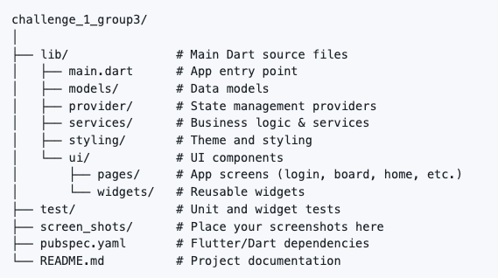
Project Structure

Slide 7
Features Summary
User Login/Signup
Persistent session with auto-login
Create/Edit/Delete Boards
Task creation with title, description, member assignment
Drag and drop between To Do, Doing, Done columns
Profile editing
Local storage with Shared Preferences

Slide 8
User Authentication
Files: login_screen.dart, signup_screen.dart
Sign up/login with email and password
Session persisted across launches
Redirects to HomeScreen on success

Slide 9
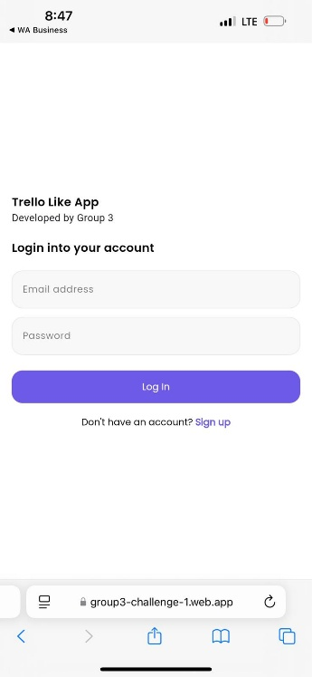
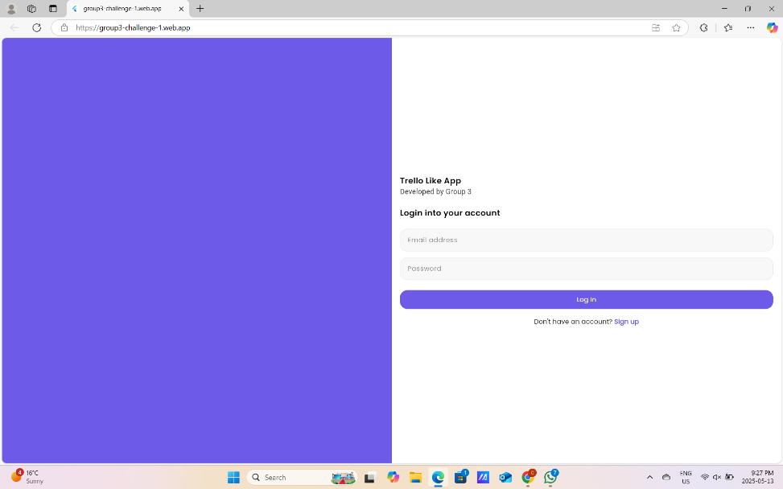
User Authentication

Slide 10
Home Screen & Boards
Implemented in board.dart
Displays saved boards
Each board opens a dedicated task view screen
Board model holds a list of tasks and metadata like title and members
Shows a column-based layout using ListView and drag targets

Slide 11
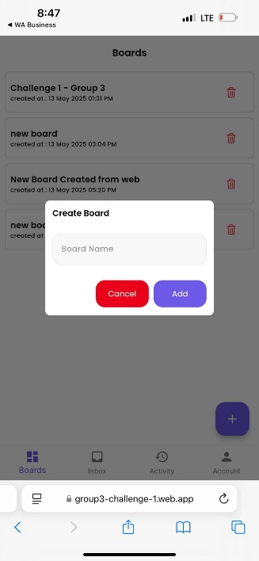
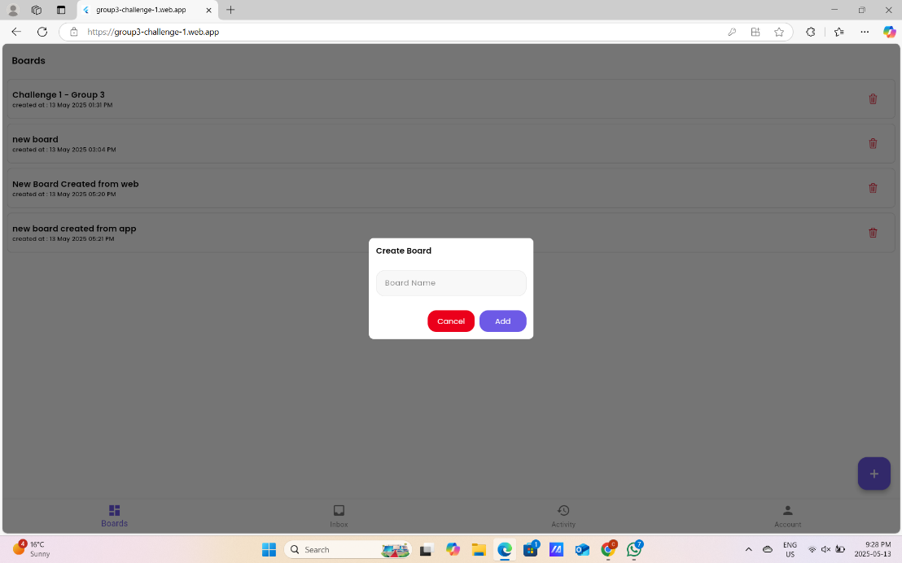
Home Screen & Boards

Slide 12
Task Management
Implemented in task.dart
Tasks categorized in columns: To Do, Doing, Done
Tasks stored as objects with title, description, status, assignees
Tasks created/edited using modal bottom sheet

Slide 13
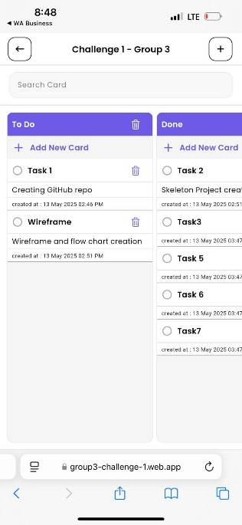
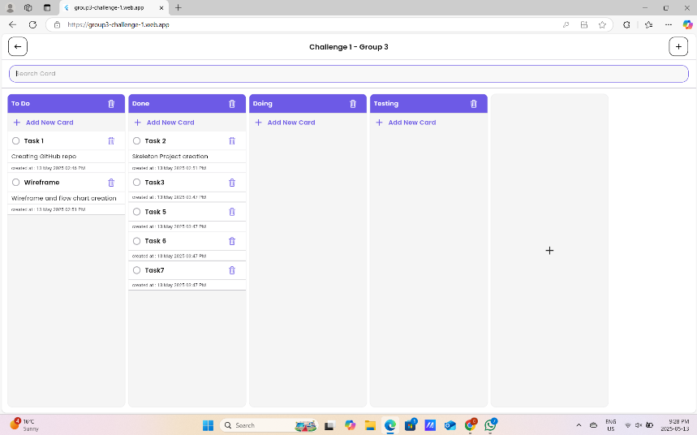
Task Management

Slide 14
Drag and Drop Logic
Implemented in board_screen.dart
Columns are DragTargets
Tasks are Draggables
When dropped, the status of the task is updated and saved using StorageService

Slide 15
Team Collaboration
File: account_screen.dart
Member Assignment: Assign team members directly to specific tasks
Profile Management: Edit username and email through the Account screen
Live Syncing: Changes reflected instantly across screens using Provider for efficient state management
Data Persistence: All changes (boards, tasks, login info) are stored and loaded via shared_preferences

Slide 16
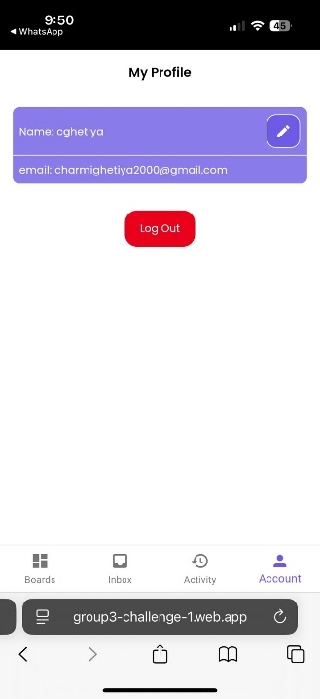
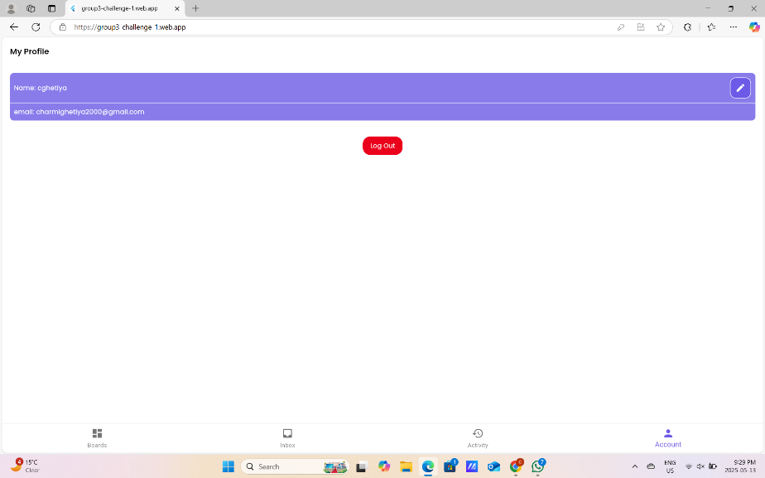
Team Collaboration

Slide 17
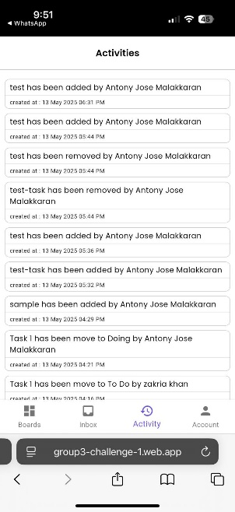
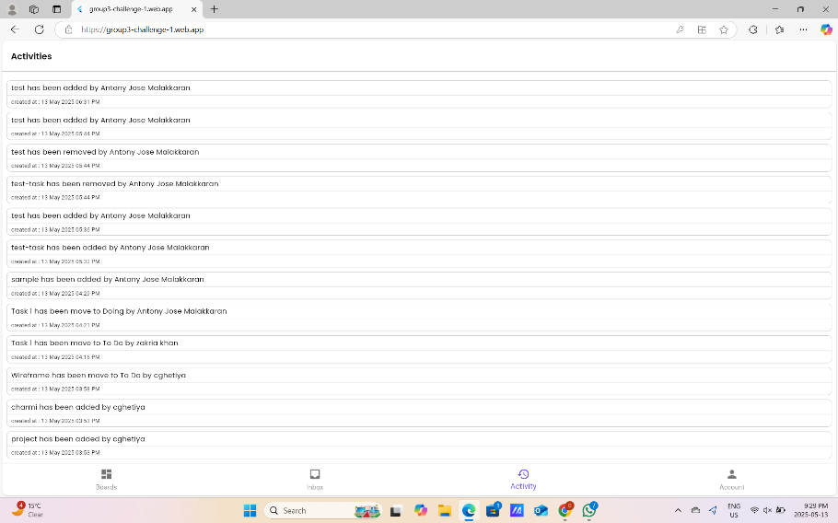
Team Collaboration

Slide 18
Workspace Management
Group related boards under specific team or project names
Quickly switch between workspaces within a unified interface
Manage multiple teams or goals simultaneously without confusion
Designed for student groups, startups, or any growing collaborative team

Slide 19
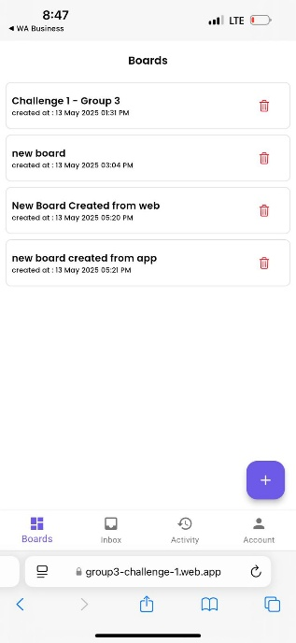
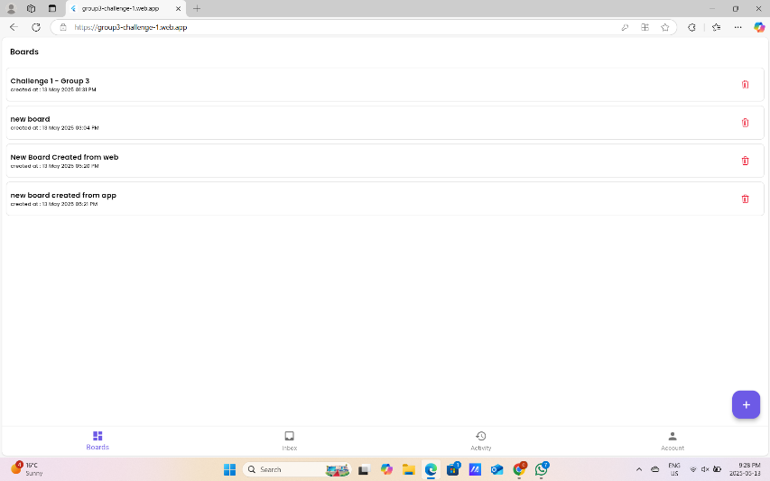
Workspace Management

Slide 20
Progress Visualization
Monitor task status across all columns — To Do, Doing, Done — at a glance
Measure team productivity based on completed tasks
Tap tasks for details, updates, and editing
Use board layout to understand workflow bottlenecks and team load distribution

Slide 21
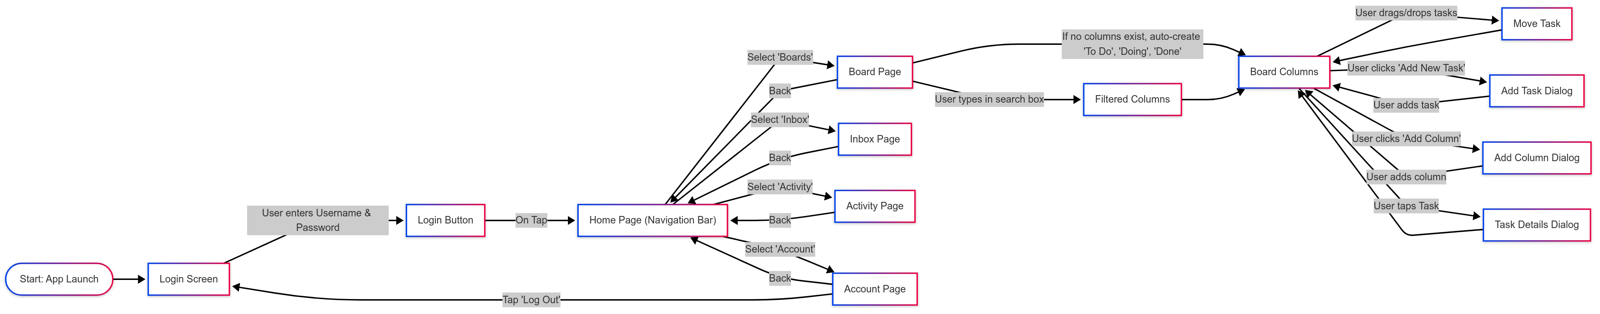
Application Flow Chart

Slide 22
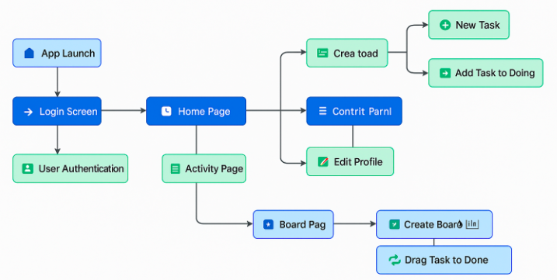
Application Flow Chart

Slide 23
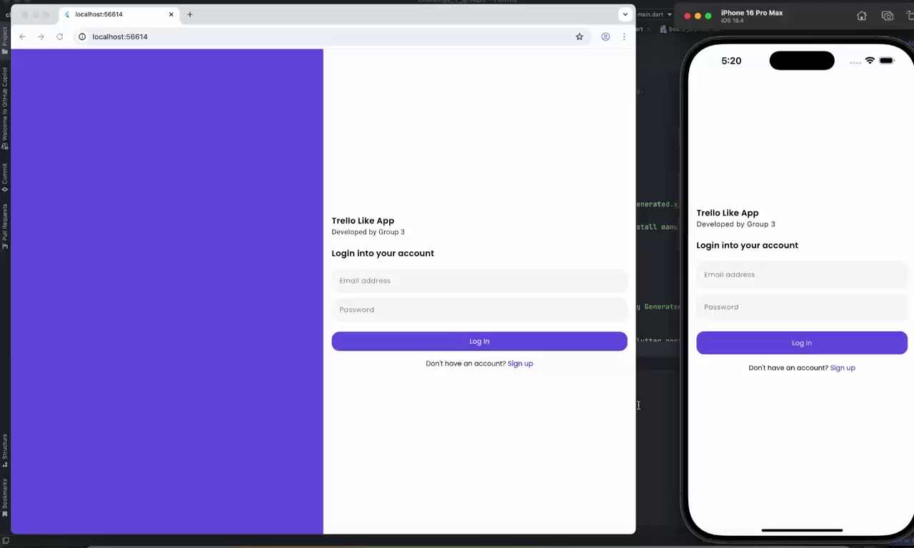
Live Demo

Slide 24
Next Steps & Future Features
Integration with Firebase for real-time syncing
Task deadline notifications
Kanban-style drag-and-drop UI improvements
Team chat module

Slide 25
Reference
Flutter: https://flutter.dev/
Shared Preferences: https://pub.dev/packages/shared_preferences
Material UI: https://m3.material.io/
GitHub Repo: https://github.com/cyclone-pk/challenge_1_group3
Dart JSON Guide: https://dart.dev/guides/json

Slide 26
Q & A
Thank you!

